Slide 1

Chrissy’s Portfolio Presentation

Slide 2
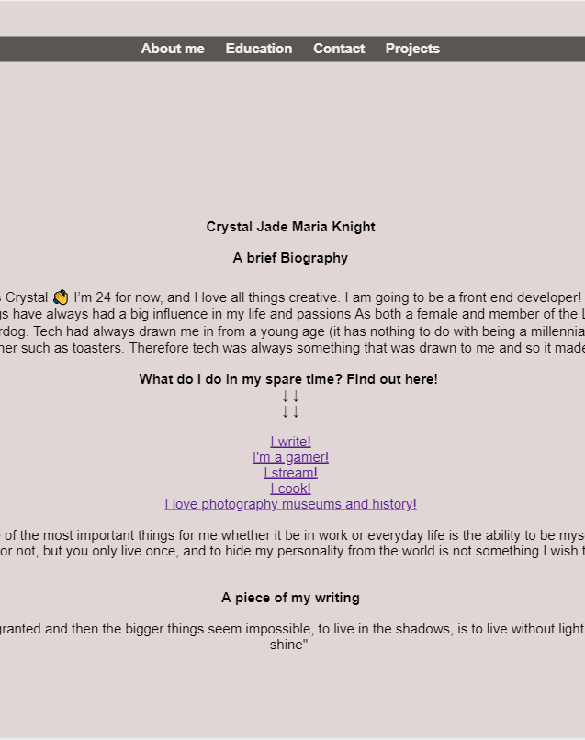
Design Decisions/ Process
I decided to keep it basic for a few reasons;
1 ) Usability: People with sensory overload or visual overload issues could face potential issues when viewing if there was to much stimuli.
2} focusing on simple designs to not deter from what it was I was doing Ie portfolio.
3) Making it functional was my main priority.
4) I added a bit more personality to showcase I have a life outside of coding, (links to some of my websites/ hobbies)

Slide 3
GOOD VS Bad
Challenges
Favorite parts
The challenges I faced came in many, some quicker to fix then others.
Trying to figure out what to put on the portfolio was the hardest part I think, as I don’t have a lot of work experience.
I think while also the feeling of vulnerability displaying on a portfolio as well was quite intimidating.
Some of the fun parts were getting to display personality and getting to know my self a bit better in the process.

Slide 4
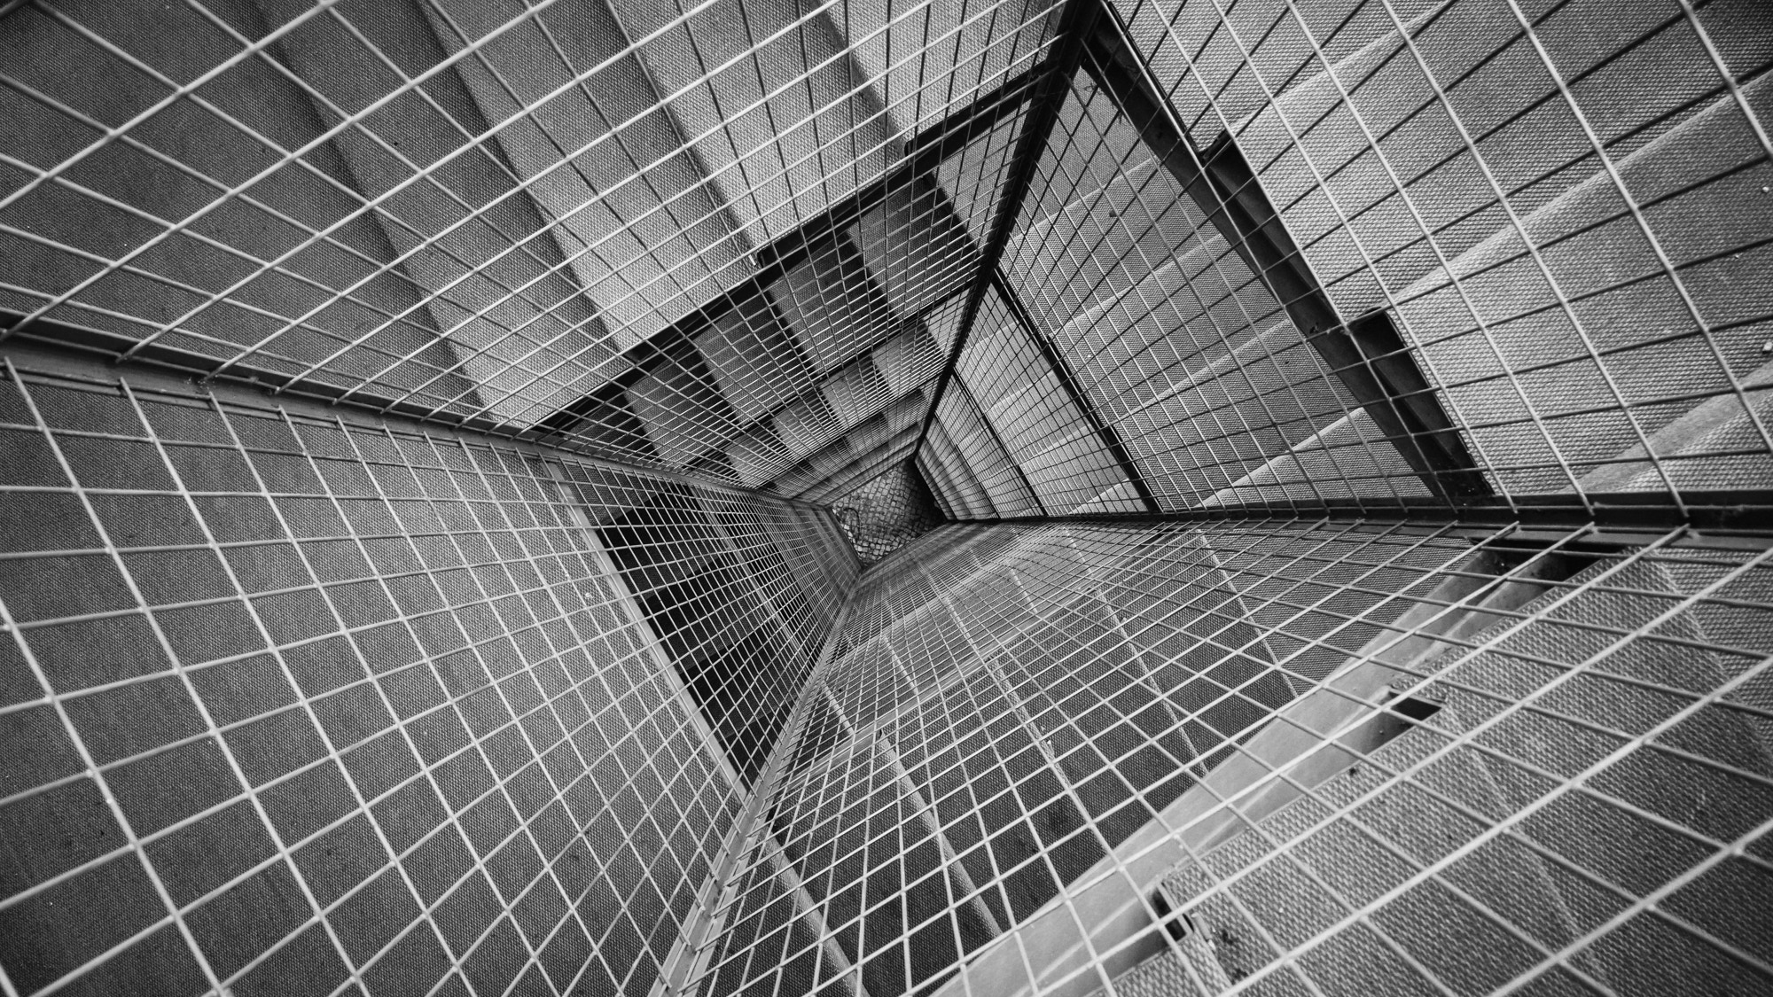
THANK YOU Any Questions??

